Slide 1
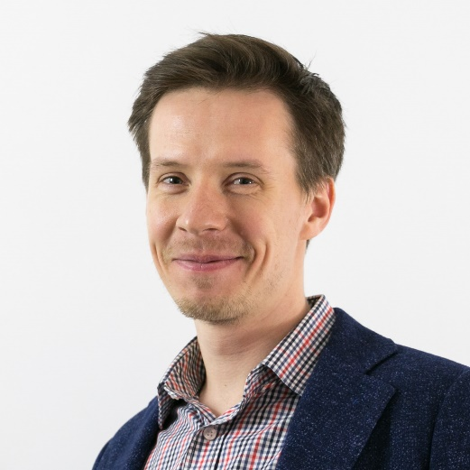
Embedding Community Investment in the Environmental & Social Standards of International Financial Institutions
Dr. Ilya Gulakov
Principal Social Consultant, RINA
The United Kingdom
ilya.gulakov@rina.org
gulakov.ilya@gmail.com
www.linkedin.com/in/ilya-gulakov/
Notes:
the topic may have a quite significant impact and has a potential

Slide 2
The Question
The practices of impact assessment have evolved over time
The concept of international development has evolved over time
What would be the next step?
Are the current practices and frameworks effective enough for achieving the goals of international development?
This presentation addresses these questions focusing on the World Bank and its private sector arm, the International Finance Corporation (the IFC)
The question is also relevant to the other IFIs (including the EBRD, ADB, AfDB and financial institutions adopting the Equator Principles)

Slide 3
Background
The WB is one of the largest organisations in the field of international development
The WB is still a benchmark institution for the global development sector
The WB started its operations almost 80 years ago
The WB provided loans to economies disrupted by World War II, and later to low-income countries
Initially, the WB operations had ‘purely economic’ character
The goal of international development was ‘economic growth’
Photo - source: The World Bank. www.worldbank.org/en/archive/history

Slide 4
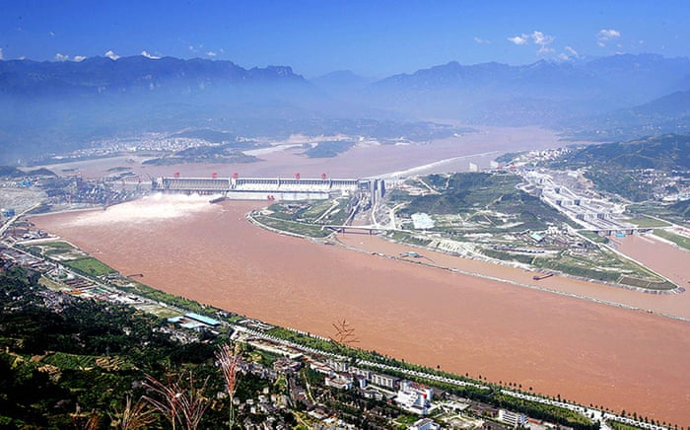
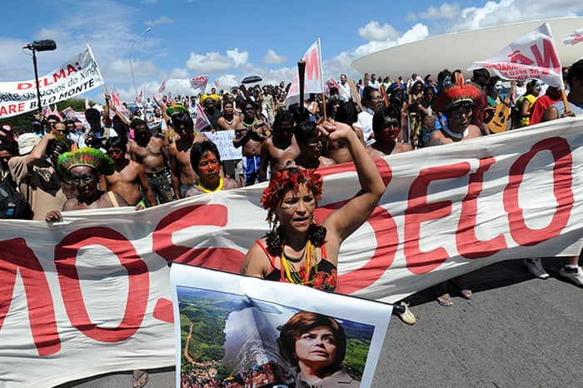
Background
Purely economic approach led to problems
For example, failure to properly resettle people for a dam project could severely impact:
people's lives
the project
the Bank’s reputation
Example: dam project in Brazil that forcibly displaced 65K people
Consideration of various risks led to adoption:
Environmental and Social safeguard policies
Environmental and Social Framework
Environmental and Social Performance Standards
Source: The Guardian. Controversial dam projects - in pictures www.theguardian.com/global-development/gallery/2012/mar/14/controversial-dam-projects-in-pictures

Slide 5
Background
One of the key drivers for considering social impacts in the Bank’s investment process was Michael Cernea
“People are – and should be – the starting point, the center, and the end goal of each development intervention”
Putting People First
In 1980s, the group led by Michael Cernea step by step pushed forward a number of important social policies, broadening development paradigm of the Bank
Notes:
Michael Cernea in the WB: 1974-1996

Slide 6
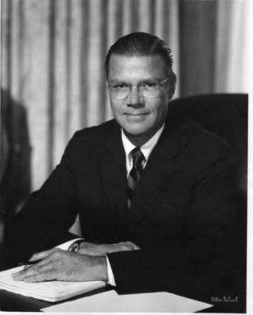
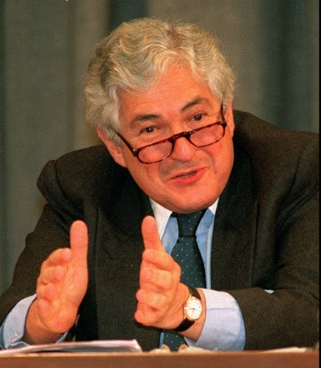
Background
Twin objectives of international development: accelerate economic growth and reduce poverty
Robert McNamara, WB President 1968-1981
Economic growth does not directly or immediately benefit the poor. ‘People don’t eat GDP’
James Wolfensohn, WB President 1995-2005

Slide 7
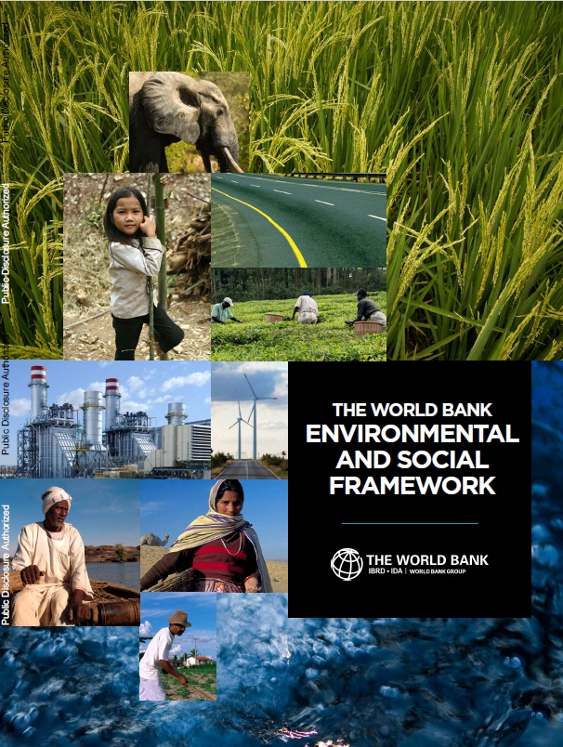
Background
Major shift in the WB performance:
Adoption of the E&S policies
Changing the goals of international development from ‘economic growth’ to ‘social development’ and ‘poverty reduction’
E&S policies apply to every project the WB finances (as appropriate)
Adoption of these policies was associated with struggle and resistance within the WB.

Slide 8
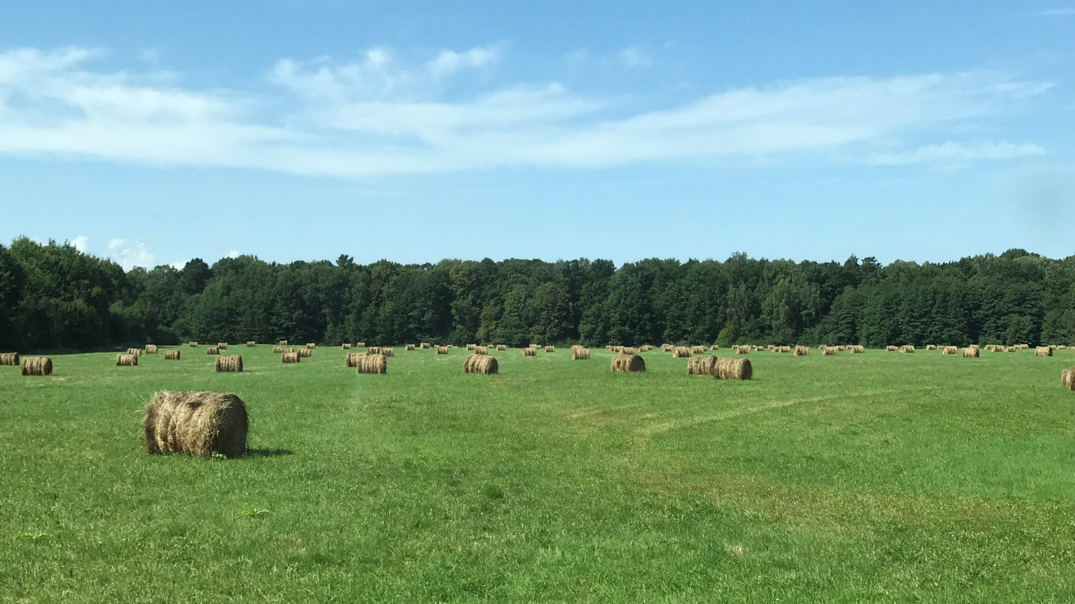
Mission of the World Bank Group
To end extreme poverty
Boost prosperity on a livable planet
Poverty is multidimensional
Are the current E&S practices and policies of the WBG effective?
Are they effectively aligned to address multiple dimensions of poverty and prosperity?
Photo - source: Author
Notes:
Level of income is the key factor but is far from being the only factor.
Access to education, health care, to participation in decision-making, etc.

Slide 9
Question
Do you think current E&S policies and practices of international financial institutions effectively address multiple dimensions of poverty?

Slide 10
Do Current Practices and Policies Effectively Address Poverty?
Despite the significant achievements made so far, the answer seems to be negative rather than positive
‘People don’t eat GDP’, or economic growth does not directly or immediately benefit the poor (J. Wolfensohn)
The two major benefits new projects are argued to bring – taxes and jobs – are not always experienced by local people
The current E&S policies are focused on assessment and management of adverse impacts. This is essential. However, this does not address multiple aspects of poverty.
‘What is in it for us?’ – a question affected communities always ask
Notes:
You can not address poverty by ‘doing no harm’. Because poverty is complex
A question which is absolutely legitimate – and that has no proper answer.
You can tell me “Hold on a second, these values are …”

Slide 11
Don’t current standards and practices consider creating benefits for communities?
Most IFIs speak about creating benefits to communities
The discussion about the necessity of creating benefits to people has been going on for decades
Covers such concepts as ‘benefit sharing’, ‘community empowerment’, ‘creating shared value’, ‘obtaining social license to operate’, ‘overcoming the ‘not in my backyard (NIMBY)’ syndrome’, etc.
Are mentioned in international standards & guidelines
However, robust ways of putting these concepts into practice have not been fully established, making these terms hollow rather than practical for many projects
Notes:
That is all true
However, robust ways of putting these concepts into practice are not fully established, making these terms hollow rather than practical for most projects

Slide 12
IFC Performance Standards
PS 1 Assessment and Management of Environmental and Social Risks and Impacts: mentions creating benefits and opportunities
PS 5 Land Acquisition and Involuntary Resettlement: aims at improvement of livelihoods and standards of living / living conditions of displaced persons
PS 7 Indigenous Peoples: speaks about creating opportunities for Indigenous Peoples to participate in, and benefit from project-related activities that may help them fulfil their aspiration for economic and social development

Slide 13
IFC Performance Standards
PS 1 declares creating benefits and opportunities rather than requires to implement it or gives any guidance on how to do it
PS 5 and PS 7
apply only when special impacts are triggered
allow for improving livelihoods primarily in the context of adverse impacts on these livelihoods
Creating benefits for people affected by all other types of impacts (traffic, workers influx, etc.) is not discussed
Notes:
For example, not all the projects – thank G-d - require expropriation or resettlement or involuntary restrictions on land
For example, if a household is not affected by land acquisition or resettlement, there is no discussion on improvement of this household’s livelihood.
If a project does not affect Indigenous Peoples, there is no discussion of benefits to IPs.
If there is no adverse impact, these two Performance Standards become not applicable – as well as creation of benefits.

Slide 14
Benefit sharing, community empowerment, etc.
Robust ways of putting these concepts into practice are not fully established
There are no shared expectations regarding the process of creating benefits to communities and its outcomes (among affected people, project developers, IFIs, consultancies, academia, NGOs)
Creating benefits doesn’t apply to every project (not a requirement)
These concepts are difficult to implement
Notes:
We refurbished some class in a local school last year – does it count?
As benefit sharing, as community investment
Are we in line with the letter and spirit of the Performance Standards? Or is smth else required here?

Slide 15
Summing up
Creating benefits for affected people is not required, and there is no consensus about how to do that
Current standards and practices are focused on mitigation and management of adverse impacts
There is little opportunity:
to create benefits for people affected by projects
to address multiple dimensions of poverty by applying the ‘do no harm’ principle
The opportunity to contribute to poverty reduction at project level – the level where this effort is most manageable – is missed
The question of affected people ‘What is in it for us?’ remains unanswered
Notes:
To sum up
The opportunity to address poverty at project level, starting with people affected by projects, is currently missed
An opportunity, that I believe is currently missed.
There is limited opportunity to address multiple dimensions of poverty at project level

Slide 16
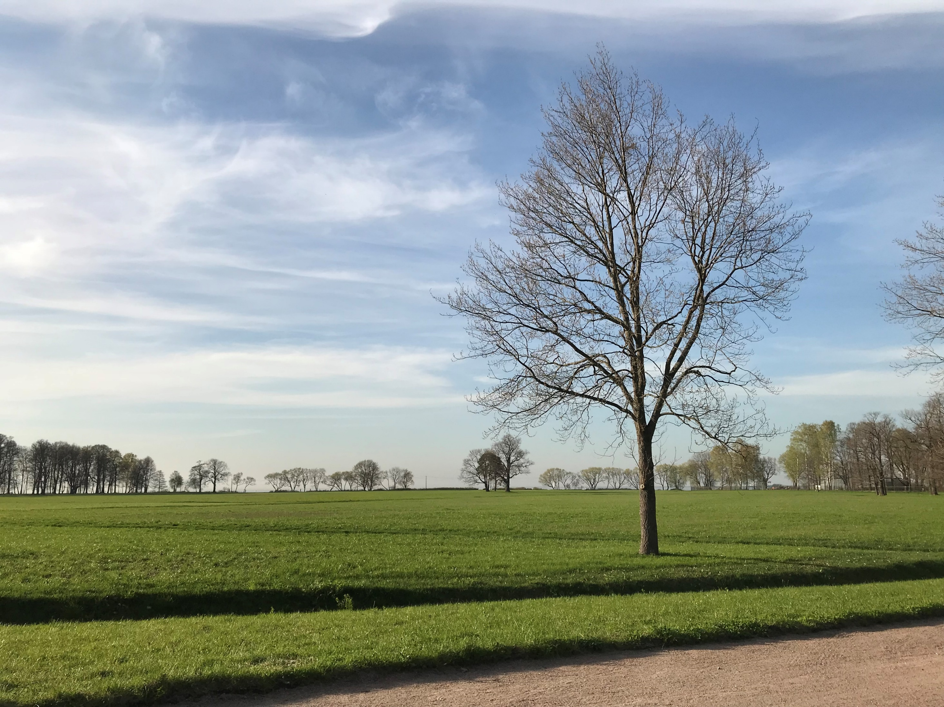
Community Investment
A significant contribution to achieving the mission of poverty reduction might be made by ensuring that community investment activities:
Are required by the WBG (and other IFIs)
Are specifically mentioned in their frameworks and policies (in particular, in the IFC Performance Standards)
Photo - source: Author

Slide 17
What is Community Investment?
Community Investment
“voluntary contributions or actions by companies to help communities in their areas of operation address their development priorities, and take advantage of opportunities created by private investment – in ways that are sustainable and support business objectives”
IFC, 2010

Slide 18
Community Investment
Is targeted on creating benefits or positive impacts of projects
Is focused on people affected by a project - though might have a broader scope
Calls for moving away from casual philanthropy towards a more strategic approach
Builds on understanding local context
Builds on community participation and shared ownership
Linked to company’s business operations
Sets a business case – by determining clear objectives, criteria, budget, etc.

Slide 19
Community Investment
How can community investment be implemented? Within what framework?
Is community investment part of social impact assessment or is it a separate process?
Social Impact Assessment is the process of analysing, monitoring and managing social consequences, both positive and negative
Notes:
The first question that we start to have when implementing community investment is …

Slide 20
Question
Is community investment part of social impact assessment – or is it a separate process?
Notes:
I would prefer not to answer this question – but propose to answer it together looking at each step of the CI process

Slide 21
Social Impact Assessment and Community Investment
Source: Gulakov and Vanclay (under review). Continuing to Put People First: Embedding community investment in the sustainability standards of international financial institutions

Slide 22
Community Investment
Community Profiling & Social Baseline Survey

Slide 23
Community Profiling & Social Baseline Survey
CI is based on local knowledge and data
Community Profiling & Social Baseline Survey
Aimed at gaining understanding of project area
Focused on those communities that are affected (‘project Area of Influence’)
Sometimes CI might be extended to a wider district or region
Largely informed by SIA results
A different approach is needed for collecting baseline information for CI
Source: Nord Stream 2 (2017). Russian Social Impact Assessment. London: Environmental Resources Management Limited
Gulakov, I., Vanclay, F., Arts, J. 2020. Modifying social impact assessment to enhance the effectiveness of company social investment strategies in contributing to local community development. IAPA https://doi.org/10.1080/14615517.2020.1765302

Slide 24
Community Investment & Social Impact Assessment
Social Impact Assessment
The primary goal of SIA – avoid, mitigate and manage adverse impacts
Social baseline survey as part of SIA tends to focus on those issues that relate to potential impacts
Even if other information is collected, it is usually not reflected in the SIA in detail
Community Investment
The goal of CI – to develop or to create benefits
Social baseline survey as part of CI aims at collecting information on all the key aspects of community wellbeing
Another framework is required
Source: Gulakov and Vanclay (under review). Continuing to Put People First: Embedding community investment in the sustainability standards of international financial institutions
Notes:
For example, if a project has no impact on utilities, there is usually no need to provide detailed information on it the SIA materials. Which is absolutely reasonable.
Provision of too detailed information in the SIA materials (which is not related to potential impacts) will be even misleading for the SIA process because it will make the document more ‘bulky’ and less manageable.
This information will be just briefly sketched (just for general understanding of the area).
Whether they are related to project impacts or not.

Slide 25
Impact Assessment
Community Investment
IFC Performance Standards
Social Framework for Projects
Sources: Figure 1 – IFC Performance Standards, IFC website: www.ifc.org/en/insights-reports/2012/ifc-performance-standards
Figure 2 - The social Framework for projects (simple version), Smyth, E., & Vanclay, F. (2017). The Social Framework for Projects: a conceptual but practical model to assist in assessing, planning and managing the social impacts of projects. IAPA, 35(1), 65-80. https://doi.org/10.1080/14615517.2016.1271539
Notes:
A different conceptual framework is needed for conducting CI
* PS 1 Assessment and Management of Environmental and Social Risks and Impacts
* Resource Efficiency and Pollution Prevention
* Biodiversity Conservation and Sustainable Management of Living Natural Resources
IFC framework is very good for capturing potential risks and impacts.
Whereas during the social baseline survey for the purposes of community investment we need to collect information on all the key aspects of community wellbeing.
For that reason, another framework should be used that enables capturing all these aspects.
Such as, for example, Social Framework for Projects.
It considers such aspects as: culture, land, infrastructure – and enables us collecting information on all these key aspects of people’s wellbeing.
We used adopted version of this framework several times – and it worked for us.

Slide 26
Community Investment
Analysis of Existing Development Plans & Initiatives

Slide 27
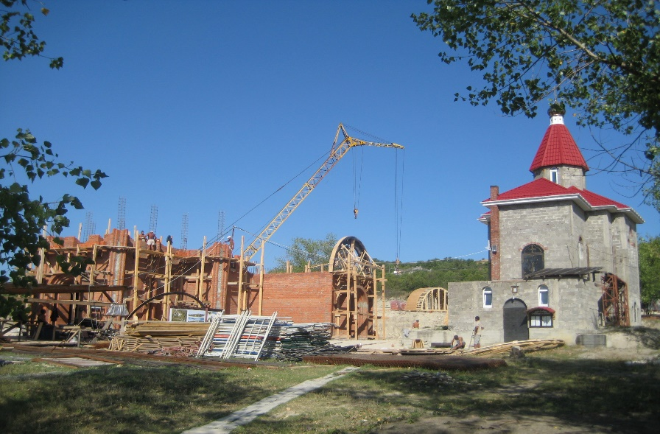
Analysis of development plans & initiatives
Analysis of planning documents of various levels: strategic, topic- and community-specific, etc.
screen the documents
identify strengths, needs & specific programmes and projects to address them
Interviewing relevant government officials
Analysis of initiatives conducted by other actors
Understand community strengths & needs as viewed by the government and other actors
Find potential partners for implementing future community investment projects
Source: Figure above: https://pmtips.net/article/planning-doc-development-plan
Figure below: author
Notes:
Screening of a pile of documents

Slide 28
Community Investment
Analysis of Community Needs

Slide 29
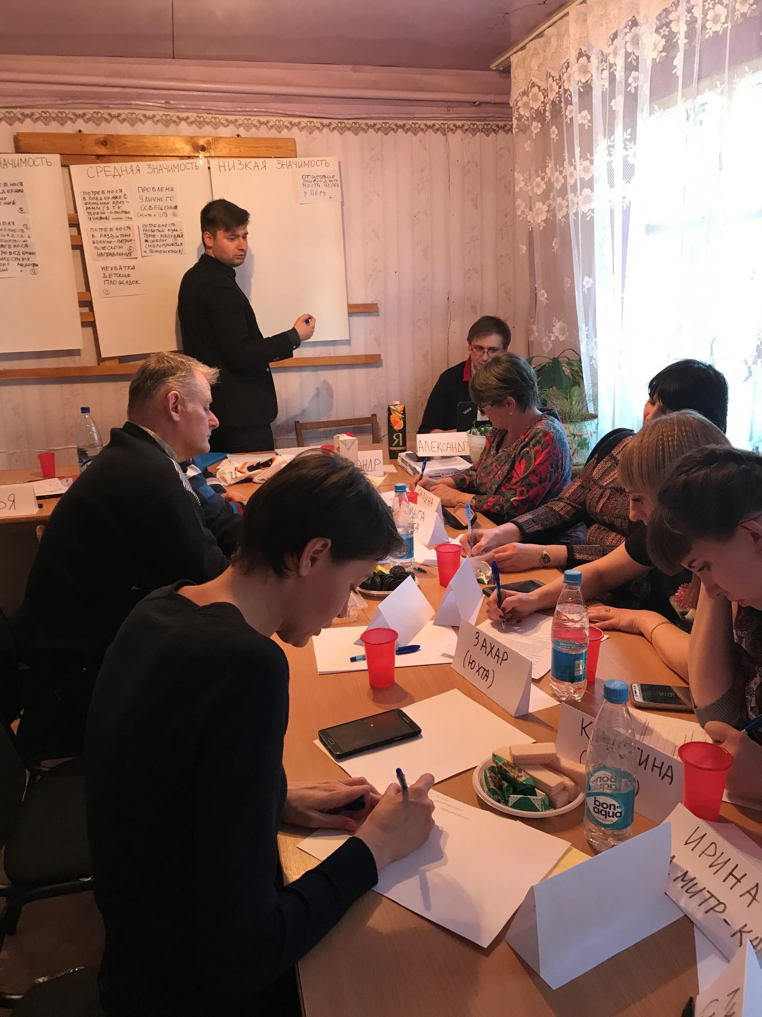
Analysis of community needs
Essential part of community investment
No one knows needs of affected people better than themselves
Engagement with communities:
Focuses on affected people
Requires careful planning (all voices are heard)
Important for a person leading engagement activities:
To explain what community investment is and what it is not (no false expectations)
To be reasonably well informed on a project, its key characteristics and E&S management
Photo - source: Author
Notes:
They are the primary people that need to be involved – not authorities, not their representatives, not some opinion leaders – lay, “ordinary” people
Planning. It should be ensured that all the communities and groups within communities are represented (in terms of gender, age, etc.)
The company is not going to perform on behalf of the government and does not even plan to.
The company is one of the actors.
This should be very clearly articulated.
Just because people tend to ask these questions all the time at the beginning of meetings (it doesn’t really matter if extensive SE activities were…)
If they do ask, it’s quite important to clearly place CI activities within the broader E&S Management System.

Slide 30
Social Impact Assessment
Community Investment
Discussing project and its impacts
Intended deliberativeness
Representative but open to all
Risk of only vocal people sharing their views
Identifying community strengths & needs
Ensuring representation of different groups (young, elderly, women, etc.)
Opportunity to listen to all participants
Source: Figure (left): www.edureform.eu/debate Figure (right): alisarut
Notes:
Before we dive into engagement activities for community investment, it’s interesting to compare…
Are they similar? Are they different? Can they be combined or not really?
There is intended deliberativeness in that kind of discussions
If there is a place to ask questions, argue, debate on a project, its impacts, etc. – this is exactly the place to do that.
There are many forms of stakeholder engagement, including public meetings, drop-in sessions, roundtable meetings – enabling these discussions. And having opportunity to deliberate is quite important here.
* If SE activities are well organised, they are Representative but open to all – there is always a risk that one part of the community might be overrepresented comparing to others
* Only vocal people – or people experienced in public speaking can share their views
* It is more like a research question?
What are the strengths, what are the needs – and what can we do about them?
If you wish, it is more like a collective brainstorming exercise

Slide 31
Analysis of Community Needs
Focus groups
Can provide meaningful information on various aspects of community wellbeing
Give opportunity to listen to all participants
Individual interviews with key informants in communities
Goal: identify community strengths, needs and ways of addressing them
Source (figure): alisarut
Notes:
And that is what we need here

Slide 32
Focus Groups
Open brainstorming discussion to identify community strengths & needs
Group-based ranking of strengths & needs to establish their relative importance (low, medium or high)
Elaborating on each community need that is of ‘high’ or ‘medium’ importance
What are the causes of these needs?
What can be done to address them?
Photo - source: Author
Notes:
These focus groups combined with interviews gives us very good opportunity to understand community needs as viewed by people.

Slide 33
Community Investment
Identification of Key Investment Areas

Slide 34
Identification of Key Investment Areas
CI is more effective when focused on a few key areas
3 key considerations for selection of key investment areas
Selection of investment areas should be:
based on methodology
transparent and (preferably) simple
Source: IFC. Strategic Community Investment: A Good Practice Handbook for Companies Doing Business in Emerging Markets (2010)

Slide 35
Identification of Key Investment Areas
Source: : Nord Stream 2, 2017. Community Investment Framework – Russia.
Gulakov, I., Vanclay, F., Arts, J. 2020. Modifying social impact assessment to enhance the effectiveness of company social investment strategies in contributing to local community development. IAPA https://doi.org/10.1080/14615517.2020.1765302
Notes:
Frank – which reference should I chose when making a presentation?
If we have some figure in our paper – but it has been taken from some other report
(say, a map for Nord Stream 2 project)

Slide 36
Identification of Key Investment Areas
Major Priority
Area 1
Area 2
High Priority
Area 1
Medium Priority
Area 1
Area 3
Low Priority
Area 1
Area 2
Area 2
Area 2
Area 3
Area 1
Negligible priority
Area 2
Key Investment Areas (example)
Community safety
Local employment
Cultural and sport activities
Infrastructure (water supply)
Living environment
A company will be committed to investing in these areas for a certain period of time
(3-5 years)
Source: author
Notes:
Living environment – green areas, beaches, children’s playgrounds, etc.
A company will be committed to investing in these areas for a certain period of time (3-5 years).

Slide 37
Community Investment
Development of Implementation Model

Slide 38
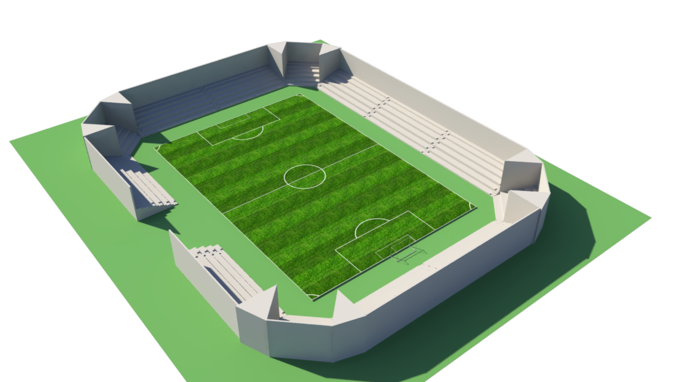
Implementation Model
Establish transparent process how to identify and select projects to support
Filter out those projects that:
Are not focused on project area of influence
Do not fall within the key investment areas
Are too expensive
Might take too long to implement (multiple permits, etc.)
Are not within the company’s ability to control
Are not viable/sustainable
Pet projects of some stakeholders
Notes:
So we determined areas that a company is going to invest in – how do we choose specific projects?
Fire truck
Proper football stadium – are there enough teams to play there? Are there enough people to watch matches? Who’s going to maintain that?
I’m not saying that a company should not get involved in expensive or complex projects – but it’s wiser to start small – and then…

Slide 39
Approaches
Proactive (partnering, capacity building, etc. having long-term agenda)
Reactive (responding to communities’ ad-hoc requests)
Ways of implementation
In-house implementation
Third party implementation
Community foundation
Multi-stakeholder partnership
Implementation Model
Photo - source: www.power-of-financial-aid.org/local-communities

Slide 40
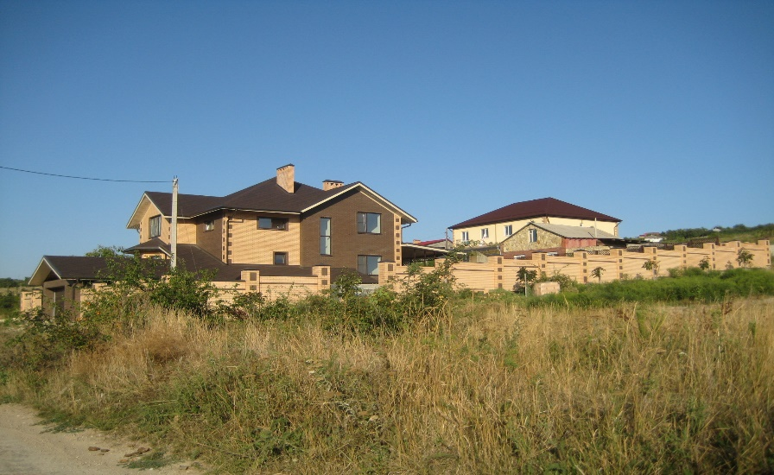
Implementation Model
Case Study: Petrochemical Project, Eastern Europe
Proactive approach – establishing Community Council
Operates according to procedure / provisions on the Council
(to determine its membership and the way members rotate, objectives, meetings’ frequency, etc.)
Aims:
- Determine projects to implement (within the key investment areas)
- Select potential partners (if applicable)
- Conduct projects’ monitoring
Includes 20 members – mostly community members but also representatives of local administrations. Other experts might be engaged as needed but they don’t vote.
Meets up every 4 months (determining projects, monitoring projects, reporting and setting up new projects)
3 company members (not part of the Community Council) take part in meetings and vote
Decisions are made by majority vote
Photo - source: Author

Slide 41
Implementation Model
Case Study: Petrochemical Project, Eastern Europe
Reactive approach – Small Grants Programme
Requirements to making applications (how to make an application, what information it should include, etc.)
Initial screening process (filtering out irrelevant projects)
Project assessment tools (does it have a clear budget & implementation plan, is the team appropriate, etc.)
Monitoring & reporting processes
Receiving applications
Initial screening
Assessment of potential projects
Making decision
Implementation monitoring
Photo - source: www.power-of-financial-aid.org/local-communities
Notes:
How long will it take, how many people will it benefit, etc.

Slide 42
Community Investment
Monitoring & Management

Slide 43
Monitoring & Management
Setting a business case for community investment
Goals
KPIs
Budget
Roles & responsibilities
Monitoring & reporting
Community Investment Plan is developed
One of the management plans as part of a company’s Environmental & Social Management System
Source: photo by Scott Graham on Unsplash
Notes:
Which makes the whole process not sporadic and casual but consistent and manageable.

Slide 44
SIA and Community Investment
Share key values and commitment to capacity building and community empowerment
Inherently participatory
Begin with community profiling and social baseline survey
Focus on people affected by a project (though CI might also have a broader scope)
Similarities

Slide 45
Community Investment has different:
Aims
Focus
all key aspects of community wellbeing
different framework is to be applied
Methodology
more extensive analysis of planning documents
different type of stakeholder engagement
selection investment areas
Manner of implementation
proactive/reactive approaches, etc.
Differences
Notes:
* Aims: SIA – primary aim of SIA is to avoid, mitigate and manage adverse impacts; CI – create benefits
* Focus: SIA focuses on those aspects that are related to negative impacts (and just briefly sketches everything else); CI focuses on all the aspects of community wellbeing
* Manner of implementation: all these proactive and reactive approaches; community councils, small grants programmes; tools for selection of projects – all that is not derived easily from the ESIA process

Slide 46
Can Community Investment benefit from Social Impact Assessment? – Yes
Does Community Investment (and creation of benefits for communities) flow naturally from Social Impact Assessment? – No
Photo - source: Author
Notes:
SIA as currently practiced does not create benefits to people affected by projects.
Positive social impacts do not happen automatically along the way.
And I think that we should be very clear and honest about that.

Slide 47
Social impact assessment as practiced today is not effective for creation of benefits and opportunities
The IFC Performance Standards:
Are effective for assessment and management of adverse impacts of projects
Fall short of achieving the goals of creating benefits and opportunities that they declare
Have limited potential to contribute to addressing multiple dimensions of poverty and prosperity
Source: Netflix. Beckham
Notes:
Because you can’t address them by ‘doing no harm’
For that reason, community investment is required

Slide 48
Community Investment
Ensures that affected people experience not only adverse but also positive impacts of projects
Has capacity to:
identify community needs and make tangible contribution to meeting them
address multiple dimensions of community wellbeing – and of poverty and prosperity
Aligned with the mission of international development
Photo - source: Author

Slide 49
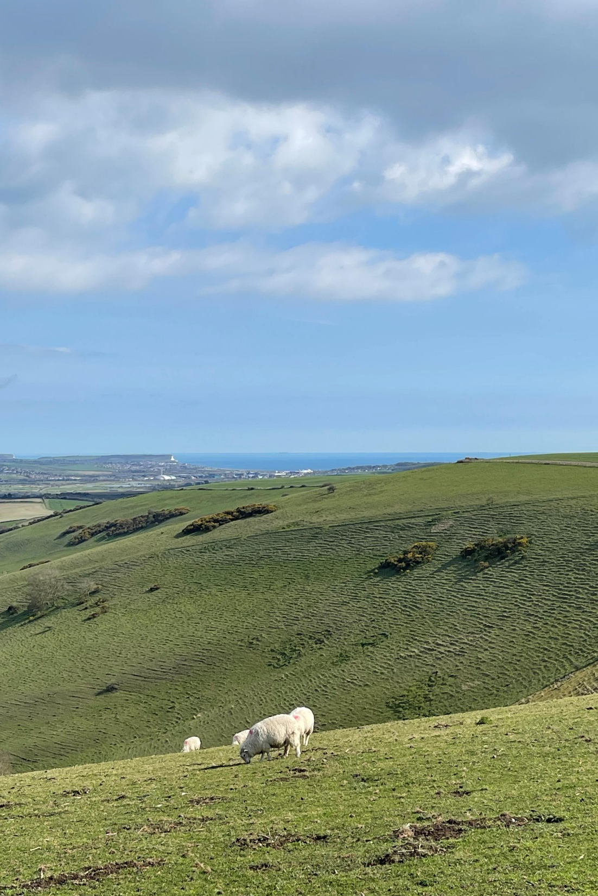
Proposed Amendment to the
E&S Standards –
in particular, to the IFC Performance Standard 1
“Clients will conduct community investment activities to help communities in their areas of operation address their development priorities and take advantage of the opportunities created by private investment. Clients will develop and implement a Community Investment Plan that is focused on affected communities, grounded in the local context and prepared based on engagement with communities. Community investment activities should not be regarded as compensation for the adverse impacts of projects, which are to be identified and managed according to the requirements of paragraphs 7–16 of this Performance Standard”

Slide 50
Embedding Community Investment into E&S Standards
Will be the next major shift in the international development process:
First – from economic development to consideration of adverse E&S impacts
Second – from consideration of adverse impacts to creation of benefits
Everything is ready for making this shift:
Guidelines
Accumulated experience
No obstacles for making this shift

Slide 51
Embedding Community Investment into E&S Standards
IFC Performance Standards
Were last updated in 2012 (discussion of their update)
Have served and still serve as benchmark for the whole international development sector
Referenced by the Equator Principles (adopted by 136 financial institutions in 38 countries)
Mentioning of Community Investment in the IFC Performance Standards
Will have a huge impact on the whole international development sector
Will make a real difference to people’s lives (first of all, to lives of affected people)
Is in line with the World Bank’s mission of poverty reduction
Gives practical tools for contributing to poverty reduction at the project level
Continues to ‘Put People First’ (M. Cernia)
Notes:
In particular, they are referenced
Now imagine for a second that Community Investment requirements are integrated into the IFC Performance Standards
It will change the whole international development sector

Slide 52
Dr. Ilya Gulakov
Principal Social Consultant, RINA
The United Kingdom
ilya.gualkov@rina.org
gulakov.ilya@gmail.com
www.linkedin.com/in/ilya-gulakov/

Slide 53
References
Information on the history of embedding social considerations into the World Bank practices
Koch-Weser, M., & Guggenheim, M. (eds) (2021). Social Development in the World Bank: Essays in Honor of Michael M. Cernea. Springer. https://link.springer.com/book/10.1007/978-3-030-57426-0
IFC Guidance Documents on Community Investment
IFC (2000) Investing in People: Sustaining Communities through Improved Business Practice. A Community Development Resource Guide for Companies;
IFC (2010) Strategic Community Investment: A Good Practice Handbook for Companies Doing Business in Emerging Market;
IFC (2015) Establishing Foundations to Deliver Community Investment: A Quick Guide.
Notes:
Whether they are affected by a project or not

Slide 54
References
Social Framework for Projects:
Smyth, E., & Vanclay, F. (2017). The Social Framework for Projects: a conceptual but practical model to assist in assessing, planning and managing the social impacts of projects. Impact Assessment & Project Appraisal, 35(1), 65-80. https://doi.org/10.1080/14615517.2016.1271539
Social Impact Assessment and Community Investment
Gulakov, I., Vanclay, F., & Arts, J. (2020a). Modifying social impact assessment to enhance the effectiveness of company social investment strategies in contributing to local community development. Impact Assessment & Project Appraisal, 38(5), 382-396. https://doi.org/10.1080/14615517.2020.1765302
Notes:
Whether they are affected by a project or not

