Slide 1

EU taxonomy of sustainable activities:
Implications for IA systems
23 March 2022

Slide 2

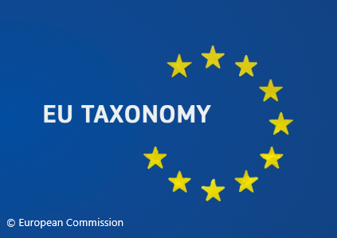





Slide 3

Webinars on demand, available to all:
  ESG: What Is It, Why Is it Important, and How Does It Relate to IA?
  COVID Impacts on E&S Field Assessment Work and many more!
Webinar 29 Mar: Emerging technologies for biodiversity IA Free
Upcoming events, including the IAIA22 annual conference and NEW online training courses
Online training and mentorship through the Professional Development Program
Free downloadable publications, like Best Practice Principles, IA FasTips, and more

Slide 4
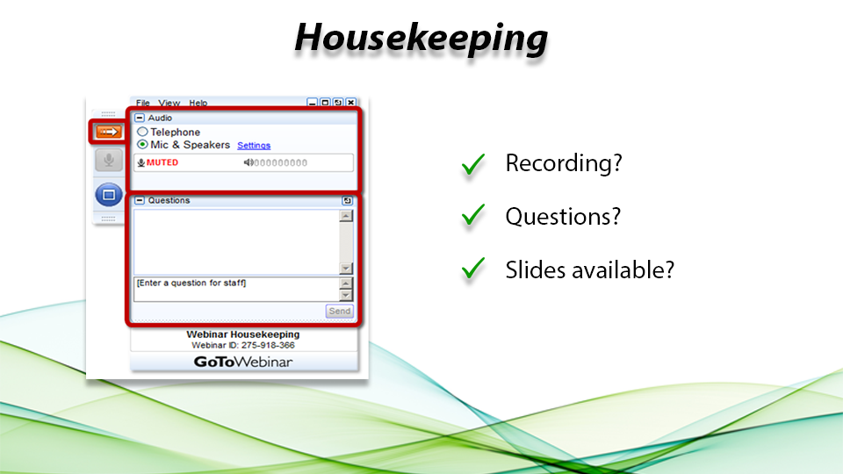

Slide 5
Taxonomies of sustainable investment
& their implications for environmental decision-making
Jiří Dusík ⏣ Integra Consulting ⎔ Prague ⎔ Bratislava ⎔ Tbilisi
Alan Bond ⏣ University of East Anglia ⎔ UK ⏣ North-West University ⎔ South Africa

Slide 6
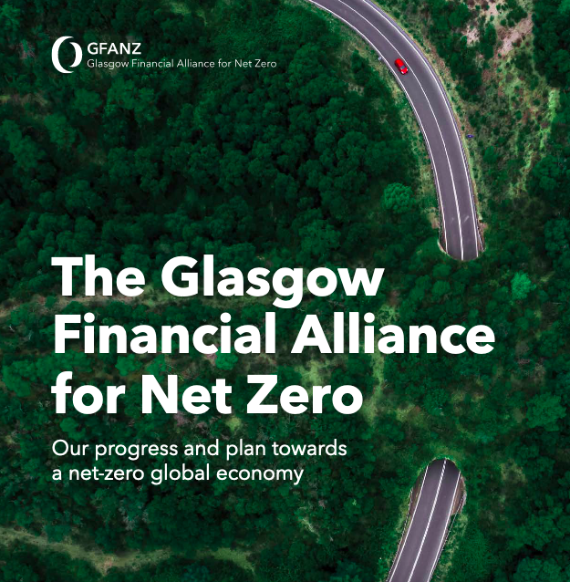
450 financial firms in 45 countries responsible for assets > $130 trillion
40% global financial assets
Set and publish a net-zero transition strategy.
Commit to transparent reporting and accounting on progress against those targets.
Adhere to strict restrictions on use of offsets.

Slide 7

Systemic difficulties with metrics used
ESG ratings vary markedly by ESG ratings provider
Each provider has a unique methodology for assigning company-specific ratings.
Notes:
Investors, must ensure the approach taken is consistent with their environmental

Slide 8

High-quality and consistent verification process will be critical
Proper regulatory oversight and verification mechanisms are essential to avoid greenwashing
Placement within sustainable finance system should not be dependent on self-reporting
Notes:
A similar issue has been IMF noted in its latest Global Financial Stability Report that highlights the need for
A proper regulatory oversight and verification mechanisms are essential to avoid greenwashing,
Placement within sustainable finance system should not be dependent on self-reporting

Slide 9
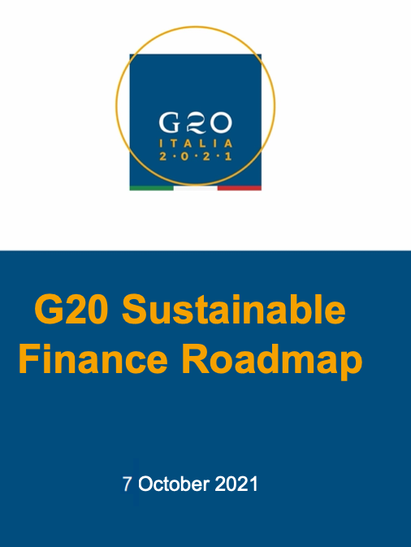
G20 high-level principles for aligning approaches and international coordination on sustainable finance:
Ensure material positive contributions to sustainability goals and focus on outcomes;
Avoid negative contribution to other sustainability goals (e.g., through do no significant harm to any sustainability goal requirements);
Be dynamic in adjustments reflecting changes in policies, technologies, and state of the transition;
Reflect good governance and transparency;
Be science-based for environmental goals and science- or evidence-based for other sustainability issues; and
Address transition considerations.

Slide 10

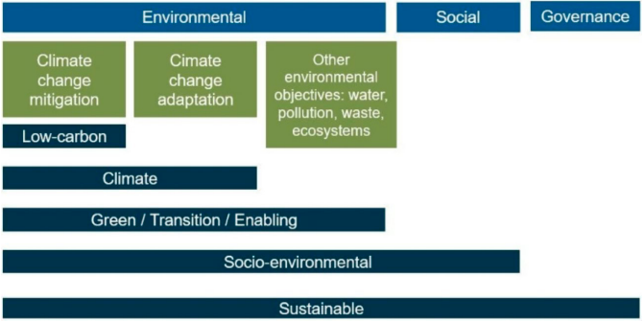
Guidance documents for spending these resources
Climate Bonds Initiative in 2012
China‘s Green Bond Endorsed Projects Catalogue
EU Taxonomy of Sustainable Activities
UK, Canada, Viet Nam…
Notes:
Taxonomies try to articulate what ‘green investments’ or ‘sustainable activities’ mean in very detailed terms. By so doing, they aim to bring clarity into fragmented markets, improve the reporting on sustainable finance, and facilitate policy and regulatory actions in this field (OECD 2020).
Green taxonomies originate back to the first “taxonomy” launched by the Climate Bonds Initiative in 2012, followed by two different green bond endorsed project catalogues by the People’s Bank of China. Shortly after this, the European Commission has in 2016 started developing a European “Taxonomy” which culminated in 2019 with adoption the Regulation 2020/852 on the establishment of a framework to facilitate (environmentally) sustainable investment, commonly referred to as the EU Taxonomy for sustainable activities.
The EU Taxonomy has a raised a bar for ‘Next Generation’ Taxonomies.

Slide 11
As of October 2021, over 30 jurisdictions were developing ‘green’ investment Taxonomies (Source: Future of Sustainable Data Alliance)

Slide 12
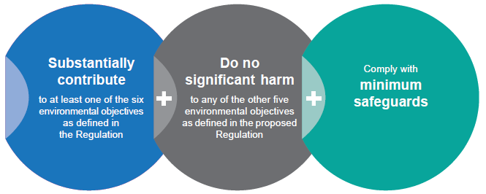

Slide 13
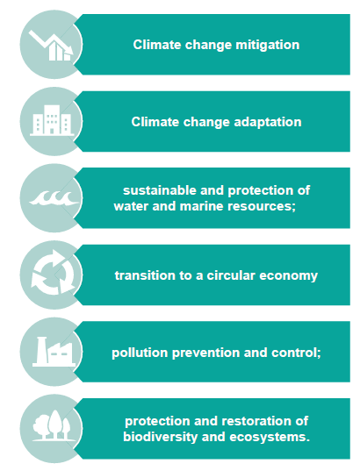
Six policy environmental objectives of the EU Taxonomy

Slide 14
Each EU Taxonomy-compliant activity
makes a substantial contribution to at least one of these environmental objectives;
does no significant harm to any other environmental objectives;
complies with minimum social safeguards; and
complies with technical screening criteria established by the European Commission through so-called Delegated Acts.

Slide 15

Example
Climate Change Mitigation

Slide 16
Framework: Taxonomy Regulation (EU) 2020/852 – Art 10
“An economic activity shall qualify as contributing substantially to climate change mitigation where that activity contributes substantially to the stabilisation of greenhouse gas concentrations in the atmosphere at a level which prevents dangerous anthropogenic interference with the climate system consistent with the long-term temperature goal of the Paris Agreement through the avoidance or reduction of greenhouse gas emissions or the increase of greenhouse gas removals, including through process innovations or product innovations, by”

Slide 17
Framework: Taxonomy Regulation (EU) 2020/852 – Art 10
generating, transmitting, storing, distributing or using renewable energy;
improving energy efficiency;
increasing clean or climate-neutral mobility;
switching to the use of sustainably sourced renewable materials;
use of carbon capture, utilisation and storage;
strengthening land carbon sinks, including through avoiding, restoring, sustainable management and restoration;
establishing energy infrastructure for enabling decarbonisation of energy systems;
producing clean and efficient fuels from renewable or carbon-neutral sources; or
enabling any of the activities listed in points (a) to (h).
Notes:
f) strengthening land carbon sinks, including through avoiding deforestation and forest degradation, restoration of forests, sustainable management and restoration of croplands, grasslands and wetlands, regenerative agriculture;

Slide 18
Technical Screening Criteria: Delegated Regulation (EU) 2021/2139
Activity code: 4.14.Transmission and distribution networks for renewable and low-carbon gases
Substantial contribution to climate change mitigation
1. The activity consists in one of the following: (a)construction or operation of new transmission and distribution networks dedicated to hydrogen or other low-carbon gases; (b)conversion/repurposing of existing natural gas networks to 100% hydrogen; (c)retrofit of gas transmission and distribution networks that enables the integration of hydrogen and other low-carbon gases in the network, including any gas transmission or distribution network activity that enables the increase of the blend of hydrogen or other low carbon gasses in the gas system; 2. The activity includes leak detection and repair of existing gas pipelines and other network elements to reduce methane leakage.
Do no significant harm (‘DNSH’)
(2) Climate change adaptation | The activity complies with the criteria set out in Appendix A to this Annex.
(3) Sustainable use and protection of water and marine resources | The activity complies with the criteria set out in Appendix B to this Annex.
(4) Transition to a circular economy | N/A
(5) Pollution prevention and control | Fans, compressors, pumps and other equipment used comply, where relevant, with the top class requirements of the energy label, and with implementing regulations under that Directive and represent the best available technology.
(6) Protection and restoration of biodiversity and ecosystems | The activity complies with the criteria set out in Appendix D to this Annex.

Slide 19

Implications for impact assessment systems?

Slide 20




‚Invisible fingerprints‘
Business consulting company
EU programme management authority
Infrastructure developer and operator
Provider of bank guarantees and project insurance
Notes:
‚Invisible fingerprints‘ of EU Taxonomy

Slide 21
Micro-level questions
Verification
What information can EIA/SEA systems provide? How to avoid duplications and streamline the processes?
3
Input data
Where can we get input data?
In what format?
1
Overlaps
What to do if our projects have to meet different environmental obligations (e.g. Taxonomy, EIA)?
2
Notes:
What needs to change in our screening of projects?
Where can we get comparable and reliable information?
In what format?
Who can ensure that we interpet the requirements of the Taxonomy well?
What to do if we would have to apply different taxonomies?
This is not a theoretical question: Imagine a central Asian country that is developing its own taxonomy and it proposes a project for co-financing by EU-based banks that will use EU Taxonomy, Chinese banks that will use Chinese Taxonomy and.

Slide 22
Meso-level questions
Scoping
Consideration of alternatives and mitigation and enhancement measures
Assessing whether and how the proposed activities meet the Taxonomy requirements
EIA review and issuance of EIA statements

Slide 23
…and the meta-level question:
What does it mean for our understanding of sustainability?

Slide 24
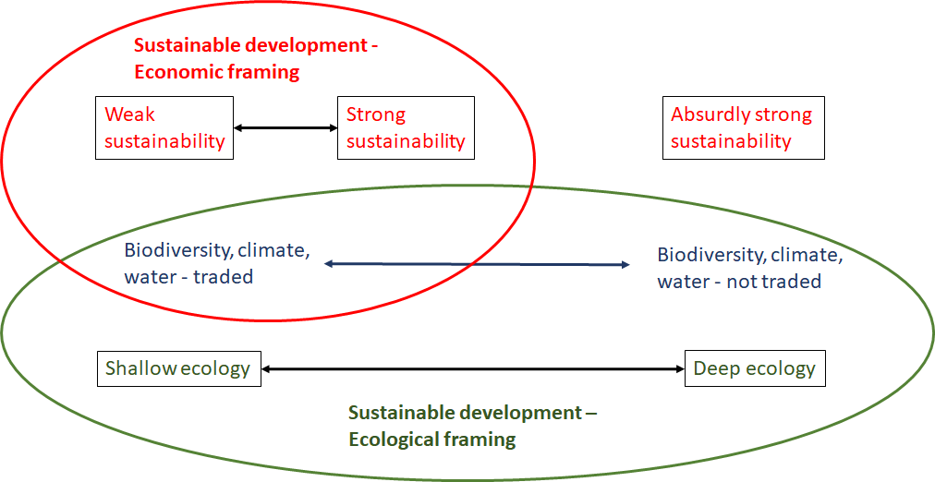
The failure of an economic discourse on sustainable development

Slide 25
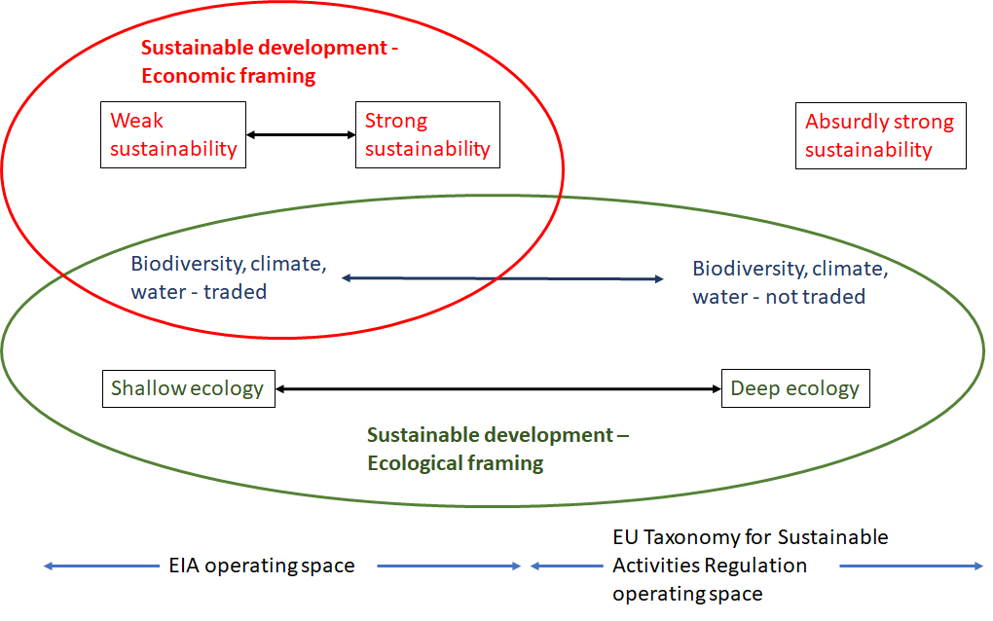
Operating space for EIA and EU Taxonomy

Slide 26
Is a mindset change possible?
Politics of decision-making
Historical precedents and lessons learnt
Averting the looming emergencies
Transitions in mindsets and systems

Slide 27
Panel
Prof. Thomas Fischer, University of Liverpool, UK and an editor of IAPA
Prof. Maria Rosario Partidario, Superior Technical Institute, University of Lisbon, Portugal
Prof. Bryan Jenkins, University of Adelaide
Angela Filipas, Senior Environmental Specialist at European Investment Bank (EIB)
Weston Fisher, co-chair of the IAIA’s Climate Change and Impact Assessment Action Plan

Slide 28
Upcoming Webinars
For members and non-members
Check out our upcoming webinar and register at https://iaia.org/webinars.php.
29 Mar: New approaches to longstanding challenges: Emerging technologies and analyses for biodiversity impact assessment

Slide 29


